Slide 1
Lecture 3: Impact of Information Retrieval
24/01/2023

Slide 2
THE IMPACT OF WEB ON IR (Ricardo Baeza)
Tim Berners-Lee conceived the conceptual Web in 1989, tested it successfully in December of 1990,and released the first Web server early in 1991. It was called World Wide Web, and is referred as Web.
At that time, no one could have imagined the impact that the Web would have.
The Web boom, characterized by exponential growth on the volume of data and information, imply that various daily tasks such as e-commerce, banking, research, entertainment, and personal communication can no longer be done outside the Web if convenience and low cost are to be granted.

Slide 3
Data Deals in IR
The amount of textual data available on the Web is estimated in the order of petabytes.
In addition, other media, such as images, audio, and video, are also available in even greater volumes. Thus, the Web can be seen as a very large, public and unstructured but ubiquitous data repository, which triggers the need for efficient tools to manage, retrieve, and filter information from the Web.

Slide 4
Result of IR
As a result, Web search engines have become one of the most used tools in the Internet.
Additionally, information finding is also becoming more important in large Intranets, in which one might need to extract or infer new information to support a decision process, a task called data mining (or Web mining for the particular case of the Web).

Slide 5
Impact IR
The very large volume of data available, combined with the fast pace of change, make the retrieval of relevant information from the Web a really hard task.
To cope with the fast pace of change, efficient crawling of the Web has become essential.

Slide 6
Impact IR continue..
In spite of recent progress in image and non-textual data search in general, the existing techniques do not scale up well on the Web.
Thus, search on text continues to be the most popular and most studied alternative.
While most search engines are based in the United States and focus on documents in English, there are important non-US search engines that have been designed for specific languages and can handle various scripts and alphabets, such as Kanji or Cyrillic. Examples include Baidu in China, Yandex in Russia, and Naver in South Korea.

Slide 7
Impact IR continue..
The search continues to be dominated by a “syntactic” paradigm in which documents that contain user specified words or patterns are retrieved in response to a query.
An alternative approach to syntactic search is to do a natural language analysis of the text.
Techniques to preprocess natural language and extract the text semantics have been around for a while, yet they are not very effective.
In fact, except for some fast entity extraction tools that have been devised recently, these techniques are too costly to be used with large amounts of data.

Slide 8
Impact IR continue..
In addition, in most cases they are only effective with well written and structured text, in combination
with a thesaurus, or other contextual information such as a specific knowledge domain.

Slide 9
Two Forms of Exploring Web
There are basically two main forms of exploring the Web:
Issue a word-based query to a search engine that indexes a portion of the Web documents.
Browse the Web, which can be seen as a sequential search process of following hyperlinks, as embodied
for example, in Web directories that classify selected Web documents by subject.

Slide 10
Exploration of Web
Additional methods exist, such as taking advantage of the hyperlink structure of the Web, yet they are not fully available, and likely less well known and also much more complex

Slide 11
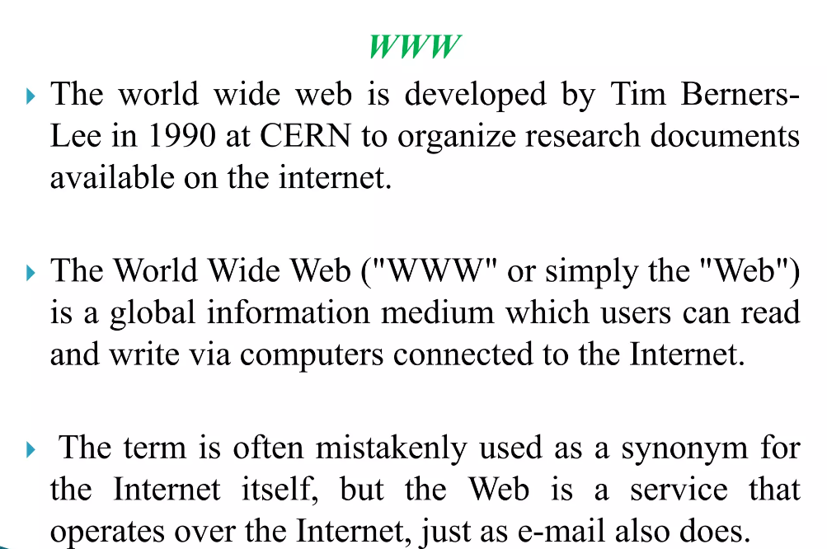

Slide 12
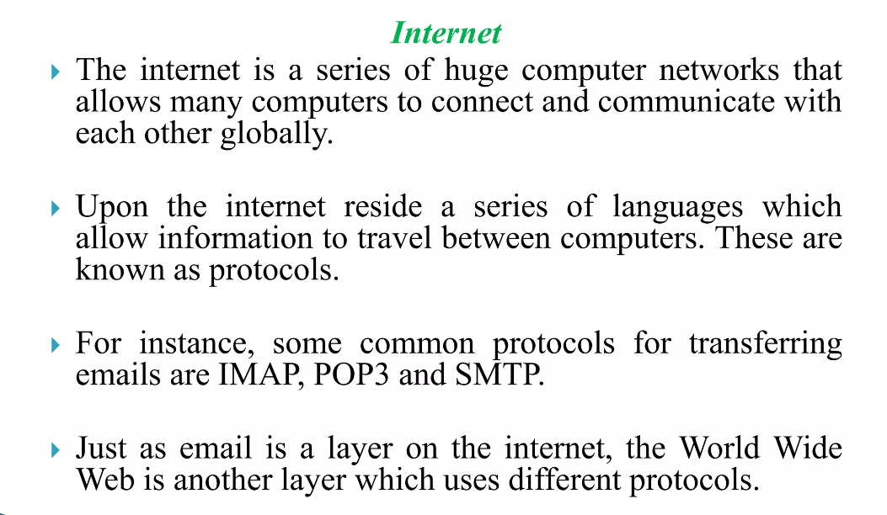

Slide 13
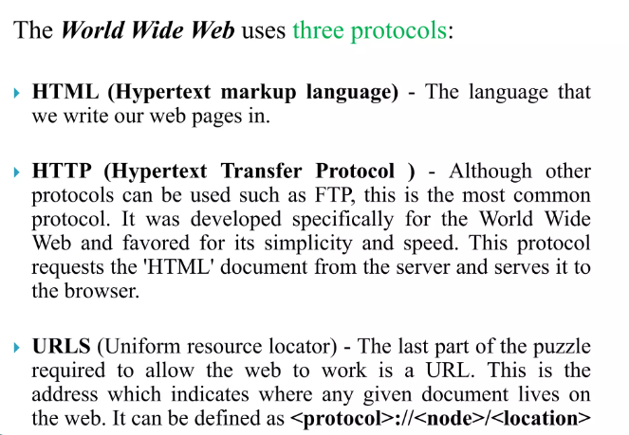

Slide 14
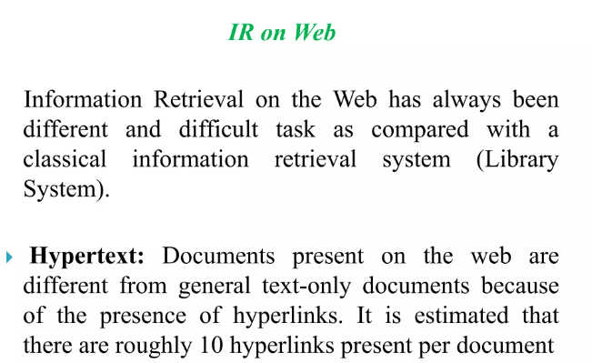

Slide 15
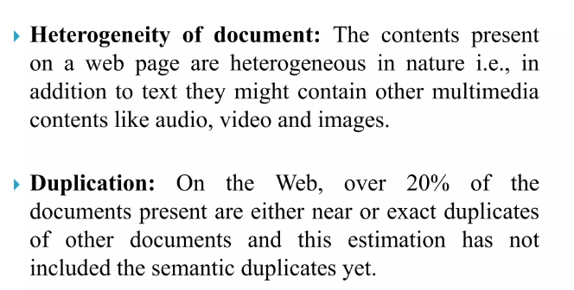

Slide 16
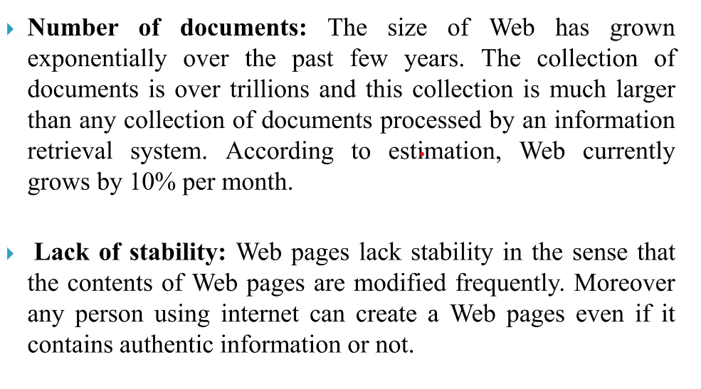

Slide 17
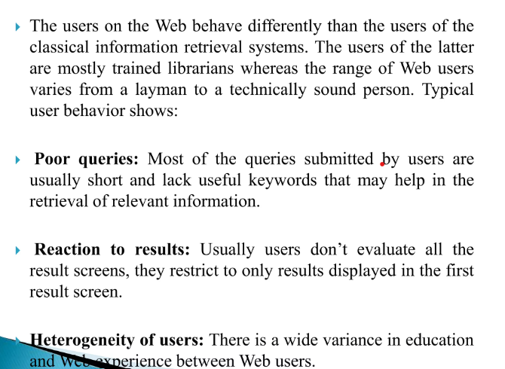

Slide 18
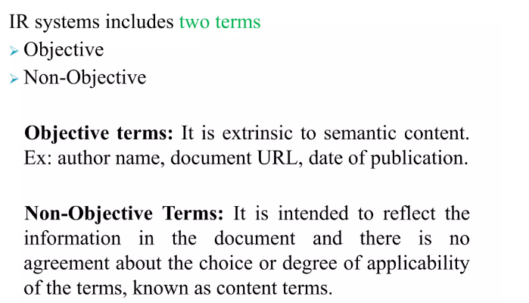

Slide 19
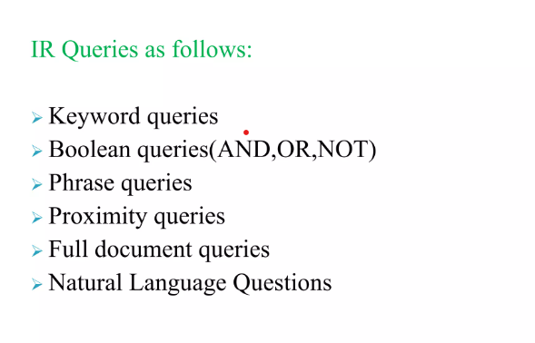

Slide 20
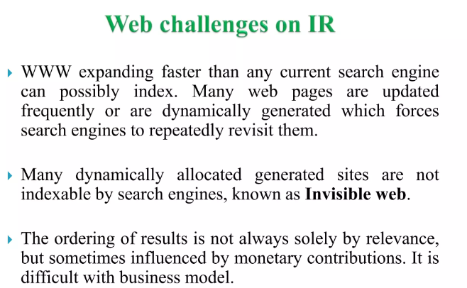

Slide 21
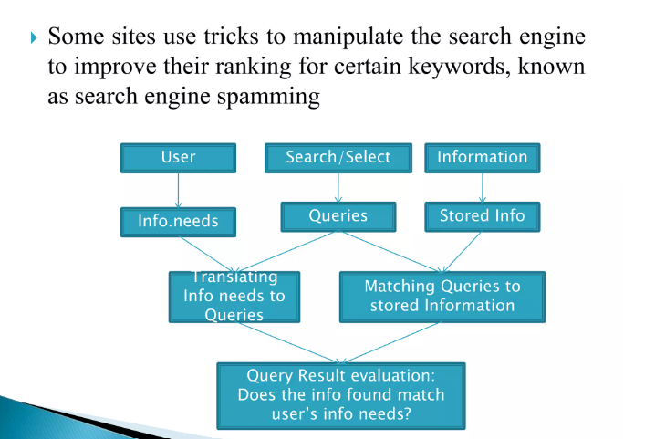

Slide 22
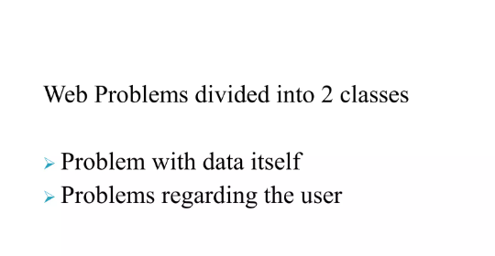

Slide 23
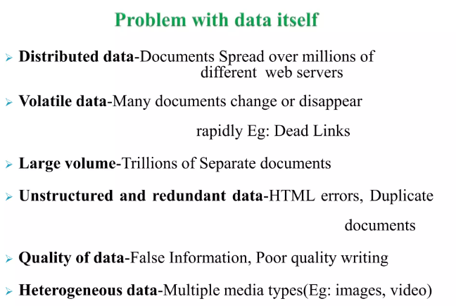

Slide 24
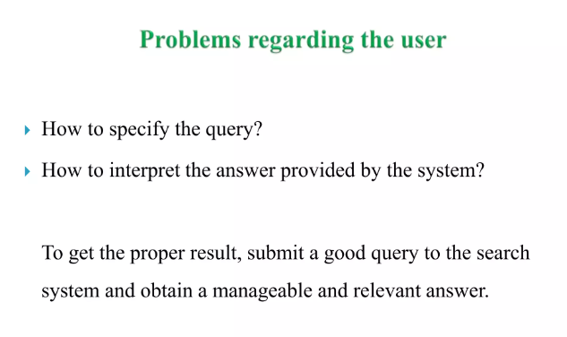

Slide 25
Classification of Data (Text)
Unstructured Data
Semi structure Data
Structured Data

Slide 26
Structured data
Structured data is data whose elements are addressable for effective analysis. It has been organized into a formatted repository that is typically a database.
It concerns all data which can be stored in database SQL in a table with rows and columns.
They have relational keys and can easily be mapped into pre-designed fields.
Today, those data are most processed in the development and simplest way to manage information.
Example: Relational data.

Slide 27
Semi-Structured data
Semi-structured data is information that does not reside in a relational database but that has some organizational properties that make it easier to analyze.
With some processes, you can store them in the relation database (it could be very hard for some kind of semi-structured data), but Semi-structured exist to ease space.
Example: XML data.

Slide 28
Unstructured data
Unstructured data is a data which is not organized in a predefined manner or does not have a predefined data model, thus it is not a good fit for a mainstream relational database.
So for Unstructured data, there are alternative platforms for storing and managing, it is increasingly prevalent in IT systems and is used by organizations in a variety of business intelligence and analytics applications.
Example: Word, PDF, Text, Media logs.

Slide 29
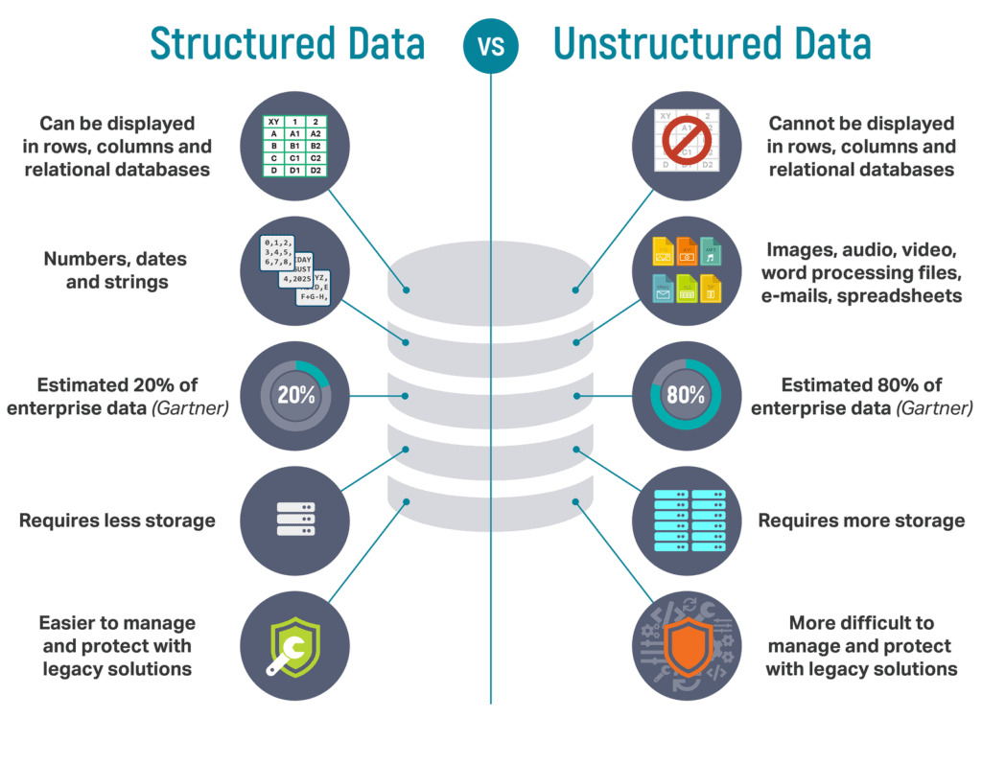

Slide 30
Properties | Structured data | Semi-structured data | Unstructured data
Technology | It is based on Relational database table | It is based on XML/RDF(Resource Description Framework). | It is based on character and binary data
Transaction management | Matured transaction and various concurrency techniques | Transaction is adapted from DBMS not matured | No transaction management and no concurrency
Version management | Versioning over tuples,row,tables | Versioning over tuples or graph is possible | Versioned as a whole
Flexibility | It is schema dependent and less flexible | It is more flexible than structured data but less flexible than unstructured data | It is more flexible and there is absence of schema
Scalability | It is very difficult to scale DB schema | It’s scaling is simpler than structured data | It is more scalable.
Robustness | Very robust | New technology, not very spread | —
Query performance | Structured query allow complex joining | Queries over anonymous nodes are possible | Only textual queries are possible

